Slide 1
Analysis of Lithium Battery Storage Systems in Kerr County
DRAFT DOCUMENT BY JEFF HOLT
JEFFREY.HOLT0302@GMAIL.COM

Slide 2
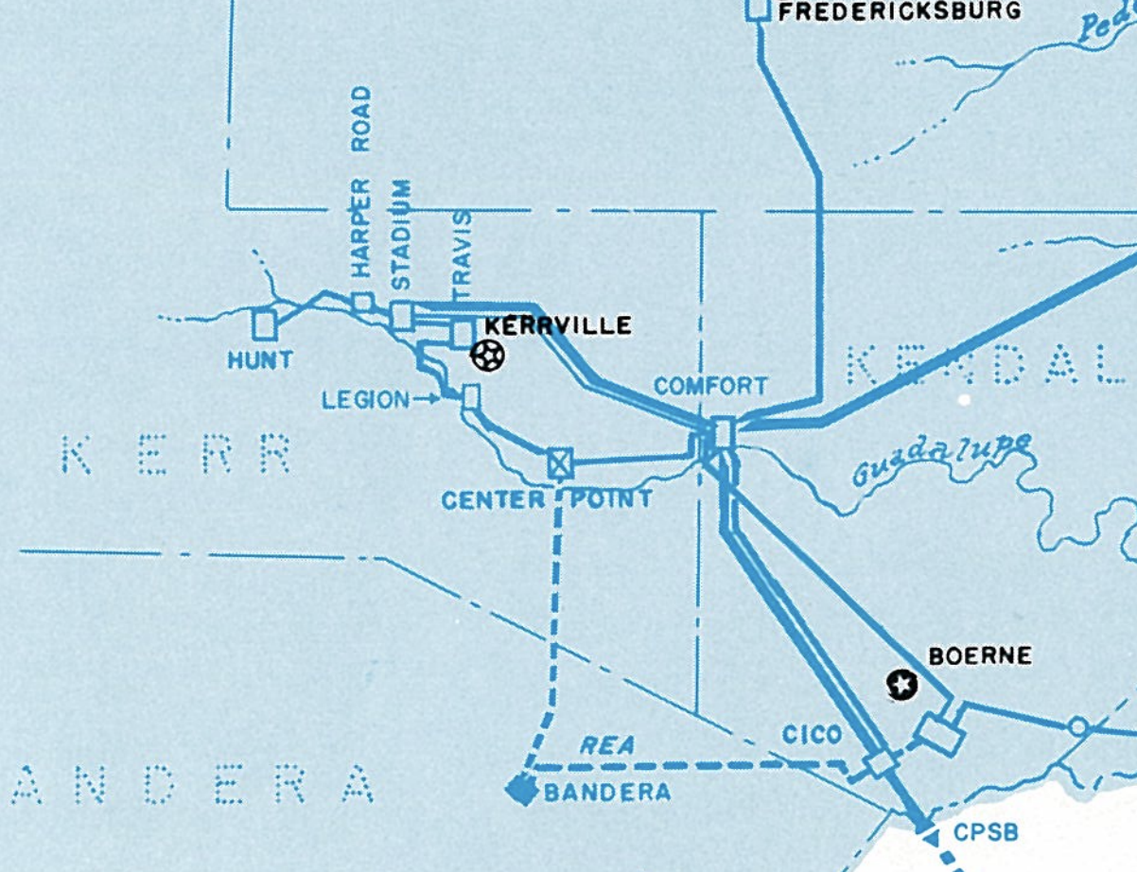
1
2
LCRA Electrical Transmission Services (1975 map)
Kerr County transmission path
The Lower Colorado River Authority (LCRA) is the primary wholesale provider of electricity for the Texas hill country for 90 years from mostly hydroelectric and fossil fuel power plants.
LCRA owns property and easements for transmission of electricity through power sources, power lines and electrical substations in residential communities.
Kerr County receives electrical power for residential and commercial properties through 7 substations operated by LCRA on this map.
There is an ERCOT effort to improve reliability of the Texas electrical power grid which includes supporting the development of Lithium Battery Energy Storage Systems adjacent to Electrical substations. 830 BESS facilities are planned in TX.
1
2
1
2
1
2
1
2
1
2
1
2
1
2
1
2
“Robust growth of inverter-based resources (IBR) has continued. More than 62 GW of transmission-connected wind, solar, and battery energy storage capacity is expected to be installed by the end of 2023…Over 7,300 MW of coal and natural gas generation has retired since 2018. ” ERCOT

Slide 3
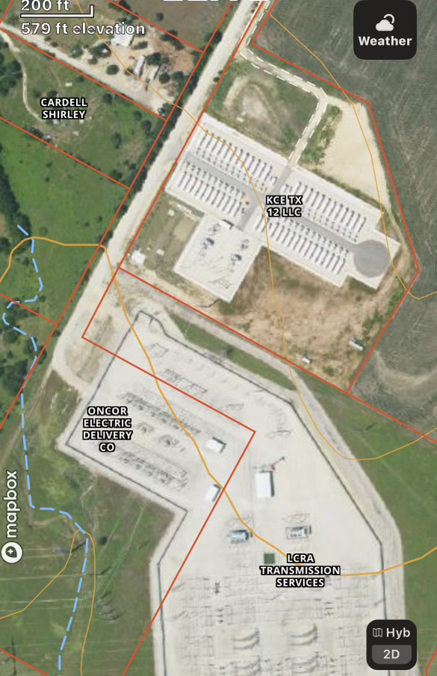
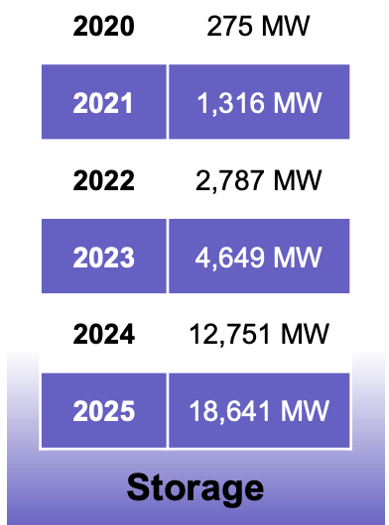
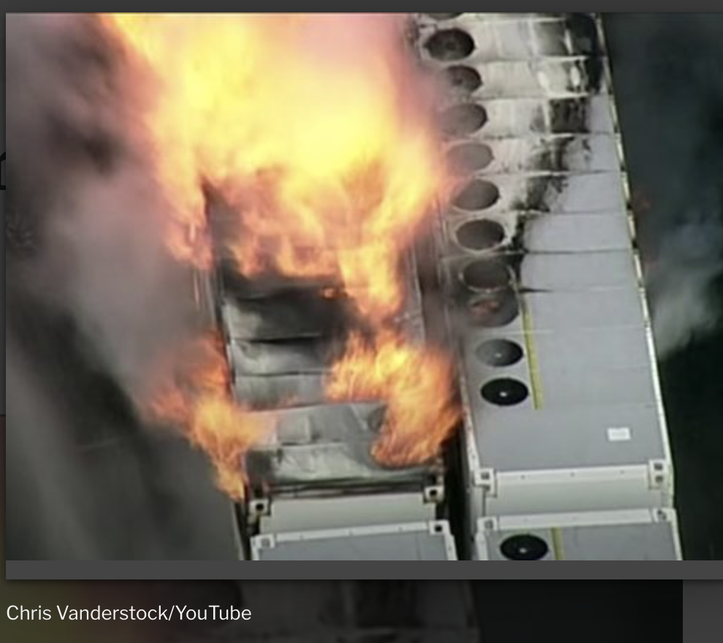
LITHIUM BESS EXAMPLE
NAME: KCE TX 12 LITHIUM BATTERY ENERGY STORAGE SYSTEM (BESS)
LOCATION: TRAVIS COUNTY, PLUGERVILLE TEXAS. HWY 45
PROJECT: 100 MW EXAMPLE SHOWN LEFT
LANDOWNERS: LCRA, KEY CAPTURE ENERGY, A SUBSIDIARY OF SOUTH KOREAN ENERGY &
CONCERNS:
NEW TECH WITH FOREIGN COMPONENTS
INCREASED DEMAND FOR BATTERY STORAGE WITHOUT ADEQUATE STATE REGULATIONS
FOREIGN PARENT COMPANIES WITH FIDICUARY INTEGRITY CONCERNS
THERMAL RUNAWAY OF LITHIUM BATTERY AGGREGATION- CA FIRE EXAMPLE LEFT
CONTAINMENT OF FIRE & SMOKE REQUIRES EXCESSIVE WATER USAGE IN A “PGMA.”
CYBER SECURITY OF KEY INFRASTRUCTURE
NO SITE RECLAMATION MANDATES
Sources:https://keycaptureenergy.com/projects/,
https://www.ercot.com/files/docs/2023/12/22/2023
https://www.theenergymix.com

Slide 4
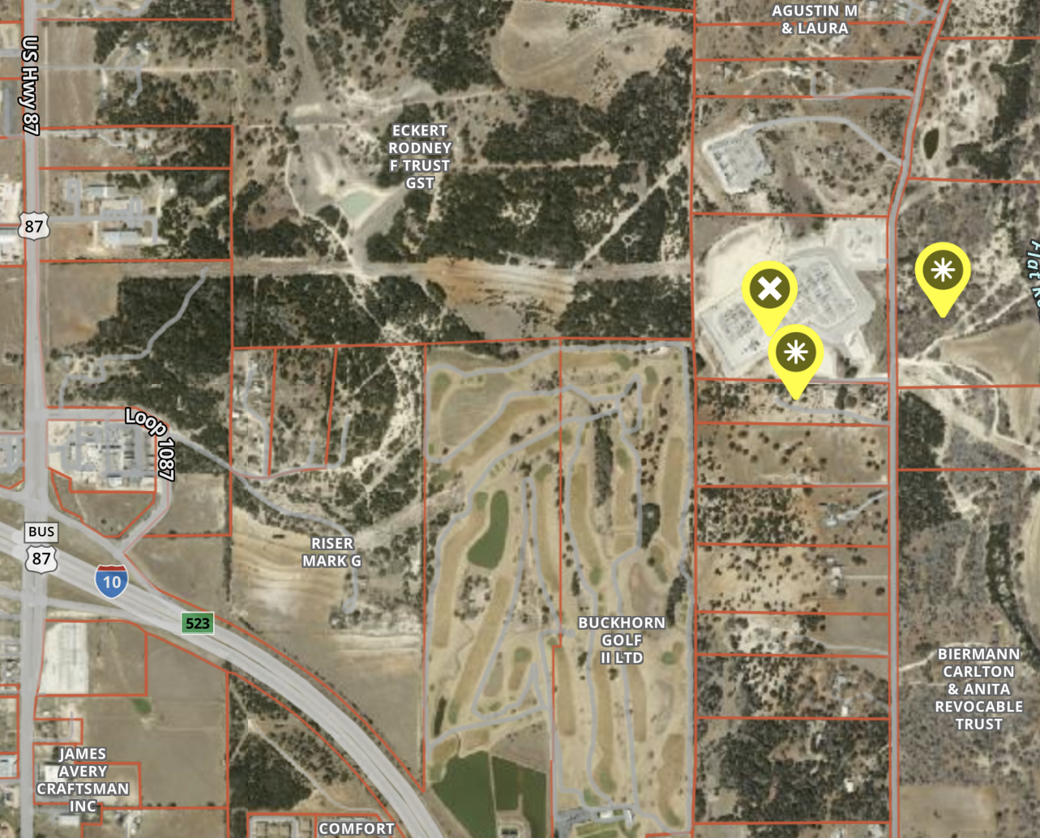
NAME: COMFORT LCRA SUBSTATION
LOCATION: FLAT ROCK CREEK RD AND FM473
PROJECTS: 100 MW LITHIUM BESS BY KEY CAPTURE ENERGY IS PENDING APPROVALS. $80M PROJECT. 18 MONTH BUILD.
250 MW LITHIUM BESS PROPOSED BY
EAST POINT ENERGY. LEASE SECURED
LANDOWNERS: LCRA, INDIVIDUAL LEASE (E) AND SALE PENDING (S).
CONCERNS:
VERY LARGE FACILITY AND THERMAL RUNAWAY OF LITHIUM BATTERY AGGREGATION
VFD CONTAINMENT OF FIRE, SMOKE, REQUIRING EXCESSIVE WATER USAGE IN A “PGMA.”
FIDUCIARY INTEGRITY OF FOREIGN PARENT COMPANIES
CYBER SECURITY OF KEY INFRASTRUCTURE
NOT ON PUBLIC WATER SYSTEM

Slide 5
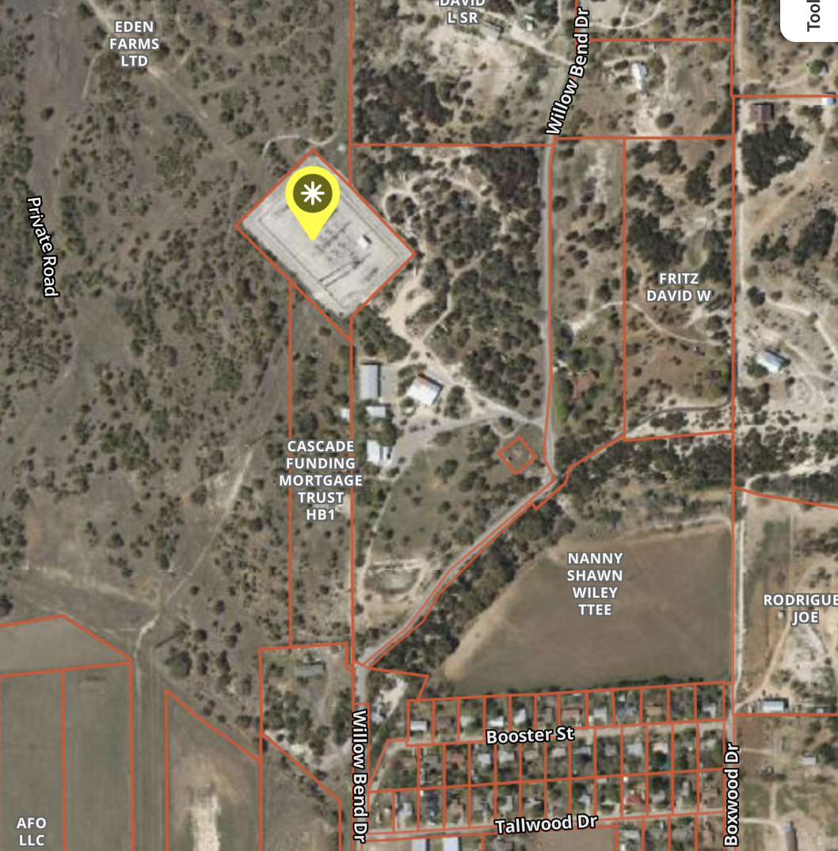
NAME: CENTER POINT LCRA SUBSTATION
LOCATION: WILLOW BEND DRIVE AND HWY 27 NEAR LITTLE LEAGUE BASEBALL FIELDS
PROJECT: ? MW LITHIUM BESS BY FORESITE RENEWABLES IS PROPOSED.
LANDOWNERS: LCRA, LANDOWNER OFFERED $5,000/MO FOR 17 ACRE LEASE.
CONCERNS:
THERMAL RUNAWAY OF LITHIUM BATTERY AGGREGATION
VFD CONTAINMENT OF FIRE, SMOKE, REQUIRING EXCESSIVE WATER USAGE IN A “PGMA.”
CYBER SECURITY OF KEY INFRASTRUCTURE
FUTURE DEVELOPMENT OF RESIDENTIAL COMMUNITY ADJACENT ON EDEN FARMS
NO KERR COUNTY APPROVAL REQUIRED
PUBLIC WATER SYSTEM NEARBY

Slide 6
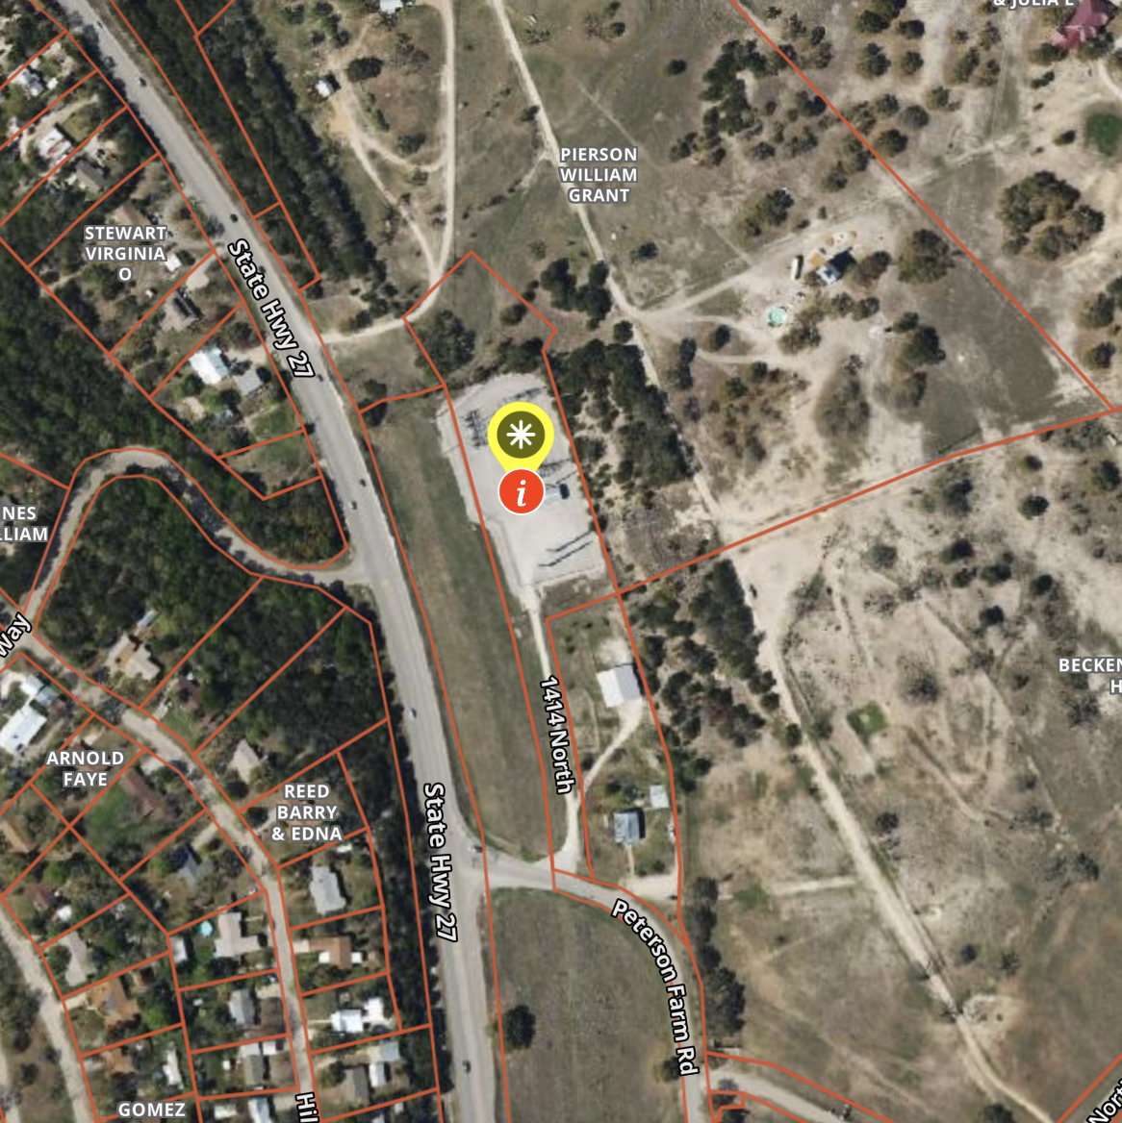
NAME: LEGION LCRA SUBSTATION
LOCATION: PETERSON FARMS RD AND HWY 27 NEAR GUADALUPE HEIGHTS
PROJECT: UNKNOWN
LANDOWNERS: LCRA
CONCERNS:
THERMAL RUNAWAY OF LITHIUM BATTERY AGGREGATION
VFD CONTAINMENT OF FIRE, SMOKE, REQUIRING EXCESSIVE WATER USAGE IN A “PGMA.”
CYBER SECURITY OF KEY INFRASTRUCTURE
AVAILABLE PRIVATE LAND ADJACENT
WITHIN KERR COUNTY LIMITS
PUBLIC WATER SYSTEM NEARBY
GUADALUPE RIVER /LAKE WITHIN 500’

Slide 7
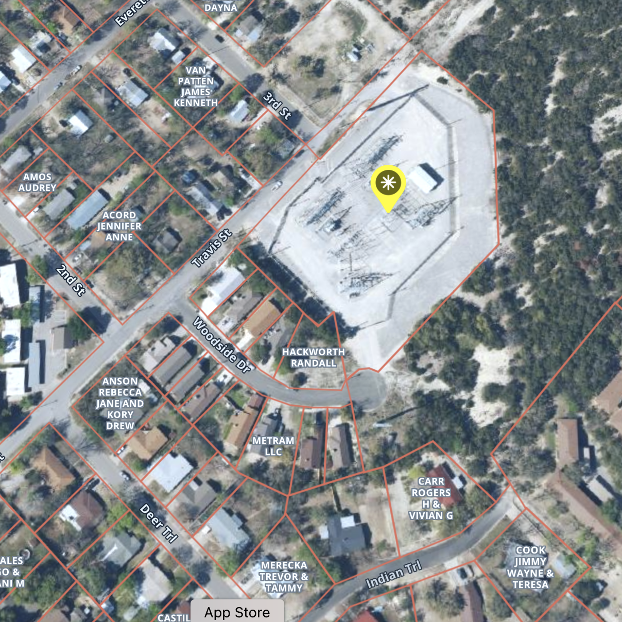
NAME: TRAVIS LCRA SUBSTATION
LOCATION: TRAVIS ST AND 3RD STREET
PROJECT: UNKNOWN
LANDOWNERS: LCRA
CONCERNS:
URBAN SETTING IN SE KERRVILLE
CONSIDERABLE ADJACENT UNDEVELOPED LAND
THERMAL RUNAWAY OF LITHIUM BATTERY AGGREGATION
KFD CONTAINMENT OF FIRE, SMOKE, REQUIRING EXCESSIVE WATER USAGE IN A “PGMA.”
CYBER SECURITY OF KEY INFRASTRUCTURE
PUBLIC WATER SYSTEM NEARBY

Slide 8
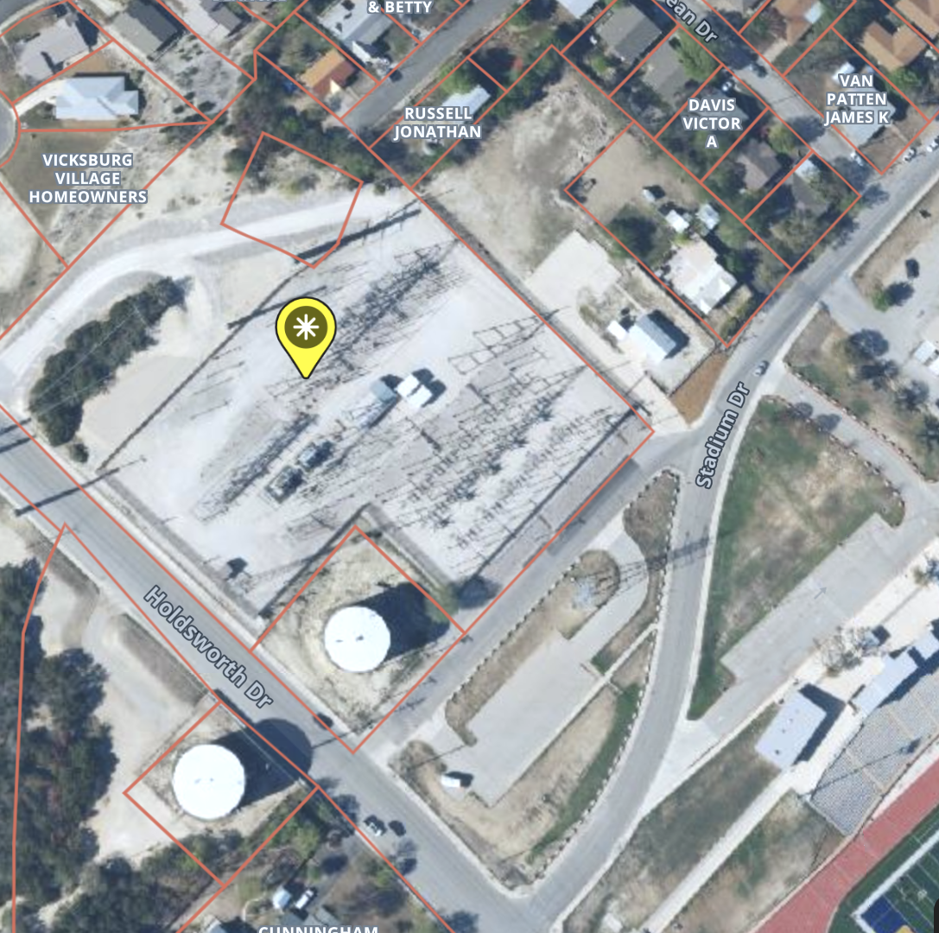
NAME: STADIUM LCRA SUBSTATION
LOCATION: STADIUM DR AND HOLDSWORTH DR
PROJECT: UNKNOWN
LANDOWNERS: LCRA AND KPUB
CONCERNS:
URBAN SETTING IN KERRVILLE / KEY INFRASTRUCTURE
THERMAL RUNAWAY OF LITHIUM BATTERY AGGREGATION
KFD CONTAINMENT OF FIRE, SMOKE, REQUIRING EXCESSIVE WATER USAGE IN A “PGMA.”
CYBER SECURITY OF KEY INFRASTRUCTURE

Slide 9
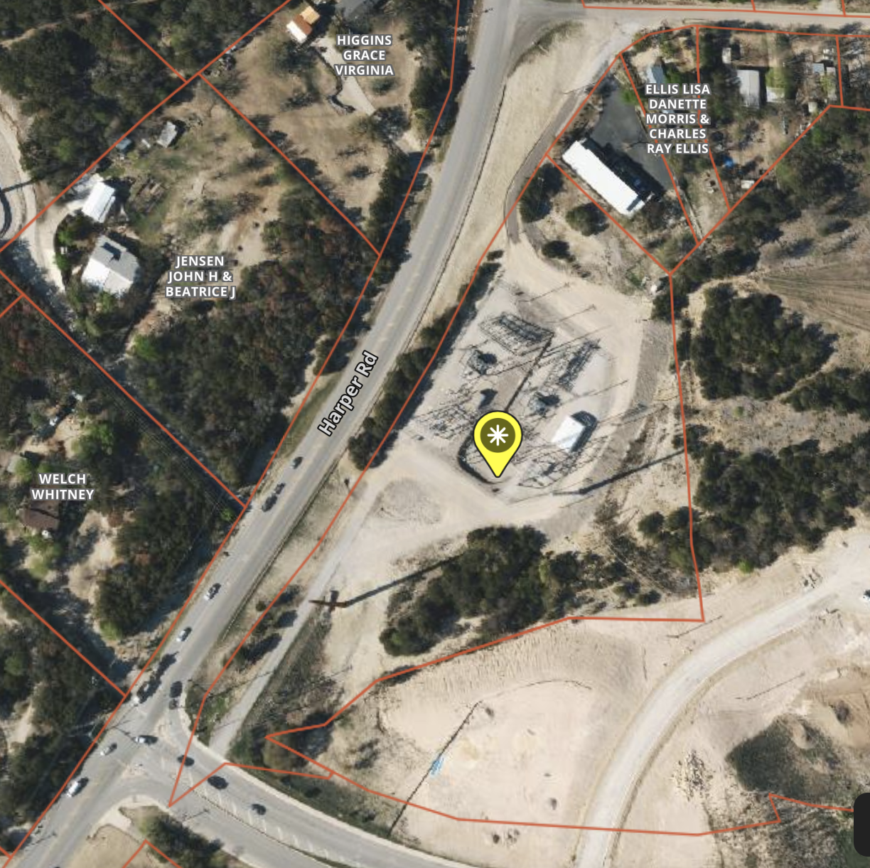
NAME: HARPER LCRA SUBSTATION
LOCATION: HARPER RD AND HOLDSWORTH DR
PROJECT: UNKNOWN
LANDOWNERS: LCRA
CONCERNS:
URBAN SETTING IN NW KERRVILLE
CONSIDERABLE ADJACENT UNDEVELOPED LAND THERMAL RUNAWAY OF LITHIUM BATTERY AGGREGATION
KFD CONTAINMENT OF FIRE, SMOKE, REQUIRING EXCESSIVE WATER USAGE IN A “PGMA.”
CYBER SECURITY OF KEY INFRASTRUCTURE

Slide 10
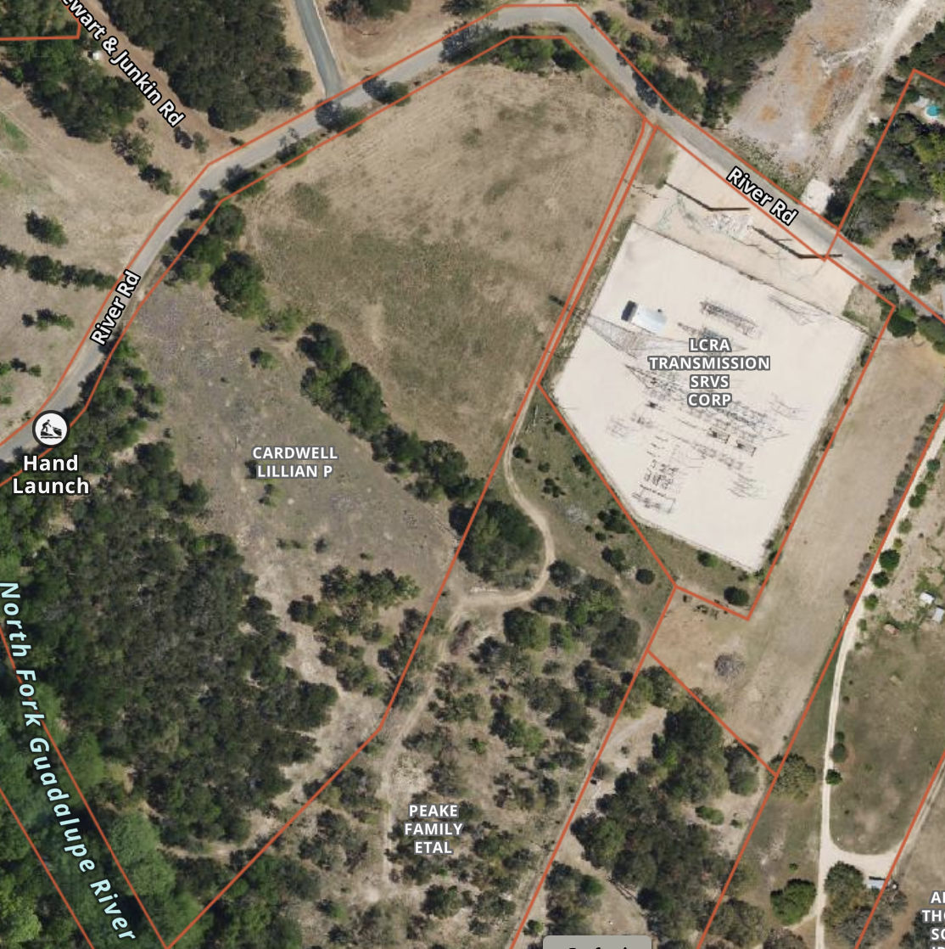
NAME: HUNT LCRA SUBSTATION
LOCATION: RIVER ROAD AND FM 1340
PROJECT: UNKNOWN
LANDOWNERS: LCRA
CONCERNS:
PROXIMITY TO NORTH FORK GUADALUPE RIVER IN CASE OF FIRE
CONSIDERABLE UNDEVELOPED LAND ADJACENT
THERMAL RUNAWAY OF LITHIUM BATTERY AGGREGATION
VFD CONTAINMENT OF FIRE, SMOKE, REQUIRING EXCESSIVE WATER USAGE IN A “PGMA.”
CYBER SECURITY OF KEY INFRASTRUCTURE

Slide 11
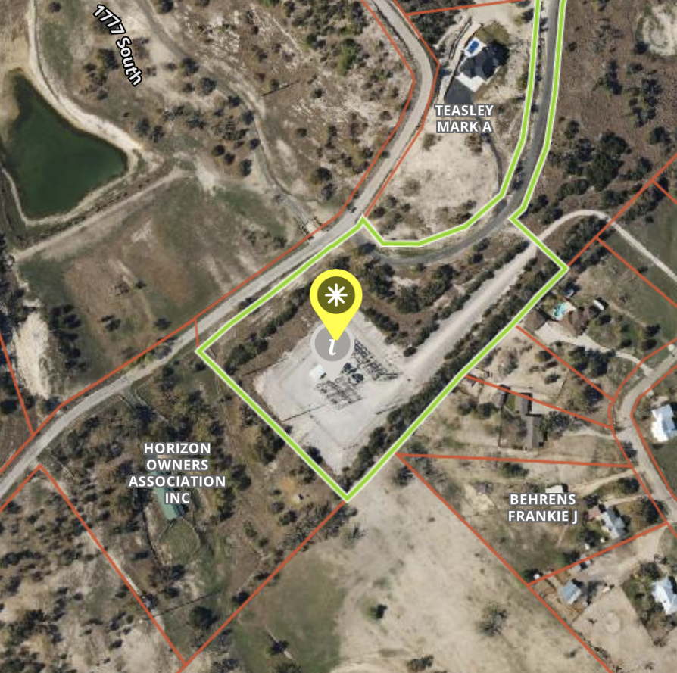
NAME: HORIZON SUBSTATION
LOCATION: HORIZON BLVD AND 1777 S
PROJECT: UNKNOWN
LANDOWNERS: MCRAE ENERGY CORP, LCRA
CONCERNS:
CONSIDERABLE UNDEVELOPED LAND ADJACENT THERMAL RUNAWAY OF LITHIUM BATTERY AGGREGATION
VFD CONTAINMENT OF FIRE, SMOKE, REQUIRING EXCESSIVE WATER USAGE IN A “PGMA.”
CYBER SECURITY OF KEY INFRASTRUCTURE

Slide 12
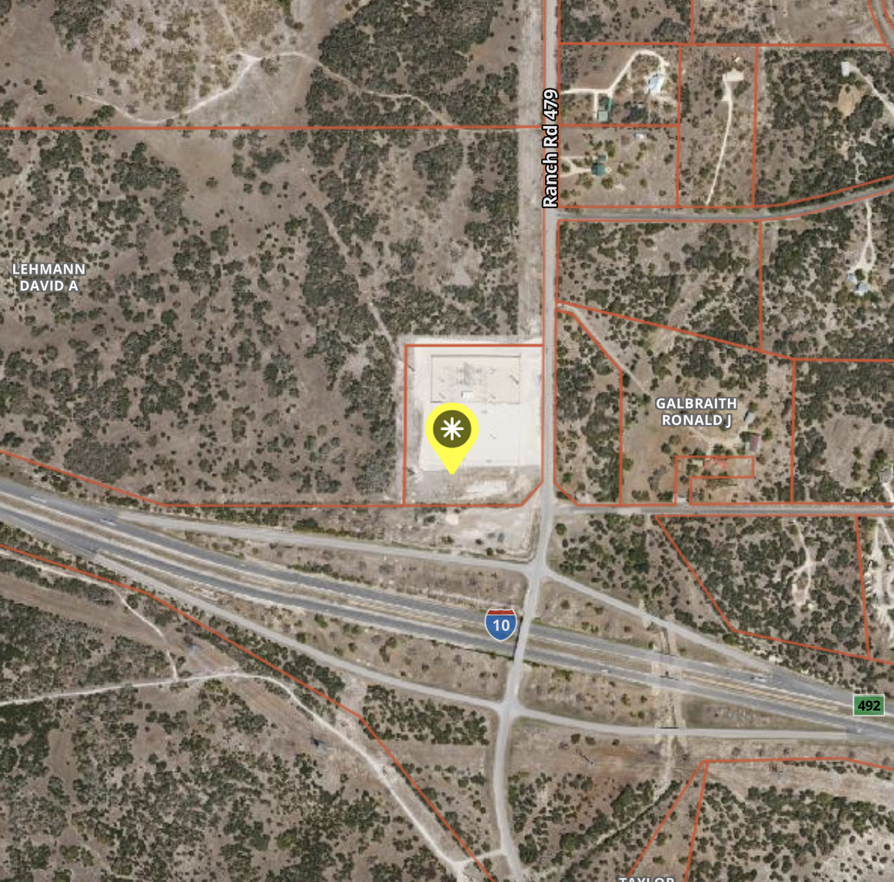
NAME: MOUNTAIN HOME LCRA SUBSTATION
LOCATION:RANCH ROAD 479 AND I-10
PROJECT: 2025-26 $87M LITHIUM BESS PLANT PROPOSED BY BLACK MOUNTAIN ENERGY. 120 MW BESS PROVIDING 2 HR POWER FOR KERR. REQUESTING ABATEMENT FOR 2026.
LANDOWNERS: LCRA, UNKNOWN LEASE/SALE
CONCERNS:
PROXIMITY TO I-10 IN CASE OF FIRE
CONSIDERABLE UNDEVELOPED LAND ADJACENT
THERMAL RUNAWAY OF LITHIUM BATTERY AGGREGATION
VFD CONTAINMENT OF FIRE, SMOKE, REQUIRING EXCESSIVE WATER USAGE IN A “PGMA.”
CYBER SECURITY OF KEY INFRASTRUCTURE
Notes:
JACKSON HUGHES BLACK MOUNTAIN
K.E. ANDREWS CONSULTANT

Slide 13
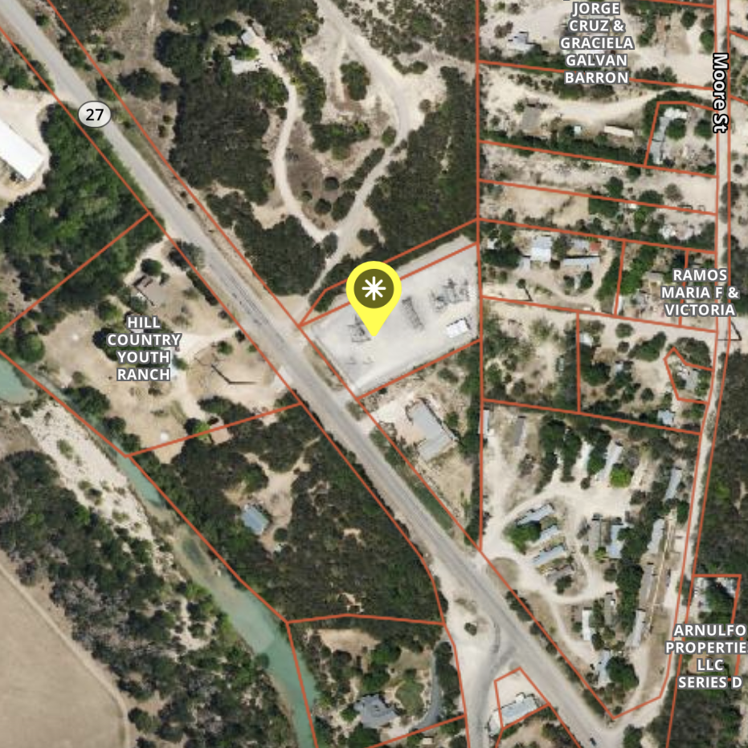
NAME: INGRAM LCRA SUBSTATION
LOCATION:HWY 27 AND MOORE ST
PROJECT: UNKNOWN
LANDOWNERS: LCRA
CONCERNS:
PROXIMITY TO HWY 27 AND JOHNSON CREEK IN CASE OF FIRE
UNDEVELOPED LAND ADJACENT
THERMAL RUNAWAY OF LITHIUM BATTERY AGGREGATION
VFD CONTAINMENT OF FIRE, SMOKE, REQUIRING EXCESSIVE WATER USAGE IN A “PGMA.”
CYBER SECURITY OF KEY INFRASTRUCTURE

Slide 14
SWOT ANALYSIS
Battery Energy Storage Systems
STRENGTHS
  GRID RELIABILITY
  TAXABLE INCOME
  JOB CREATION (BUILD PHASE)
WEAKNESS
  SYSTEM SAFETY
  LIMITED REGULATIONS
  PUBLIC PRIVATE VENTURES
  DEVALUES ADJACENT REAL ESTATE
OPPORTUNITIES
  REGULATORY COMPLIANCE
  ECONOMIC BOOST
  JOINT COLLOBORATION
THREATS
  ENVIRONMENTAL RISK
  CYBER SECURITY
  FIRE SAFETY / TOXICITY
  WATER SECURITY “PGMA”

Slide 15
STRATEGY TO MITIGATE BESS PROJECTS
COUNTY COMMISSIONERS PASS A RESOLUTION AGAINST BESS PROJECTS
CONTEST TCEQ PERMITTING BASED UPON ENVIRONMENTAL CONCERNS
PASS STATE BILL TO REGULATE BESS FACILITIES AND PROMOTE SAFETY
FORM A 391 REGIONAL PLANNING COMMISSION
ENSURE RECLAMATION BOND IS REQUIRED OF DEVELOPERS
ENFORCE CHAPTER 12 OF INTERNATIONAL FIRE CODES
PROMOTE ALTERNATIVE ENERGY SOLUTIONS; POWERPLANT DIVERSIFICATION, IMPROVE TRANSMISSION LINES DISTRIBUTION AND SMALLER SCALE ENERGY HARVESTING.

